Slide 1
Self-Supervised Denoising for 3-Dimensional Medical (MRI) Data
Nimish Magre and Rushabh Fegade

Slide 2
Contents
Problem Statement and Motivation
Self-Supervised Denoising for 3D medical data
Empirical Results
Discussion

Slide 3
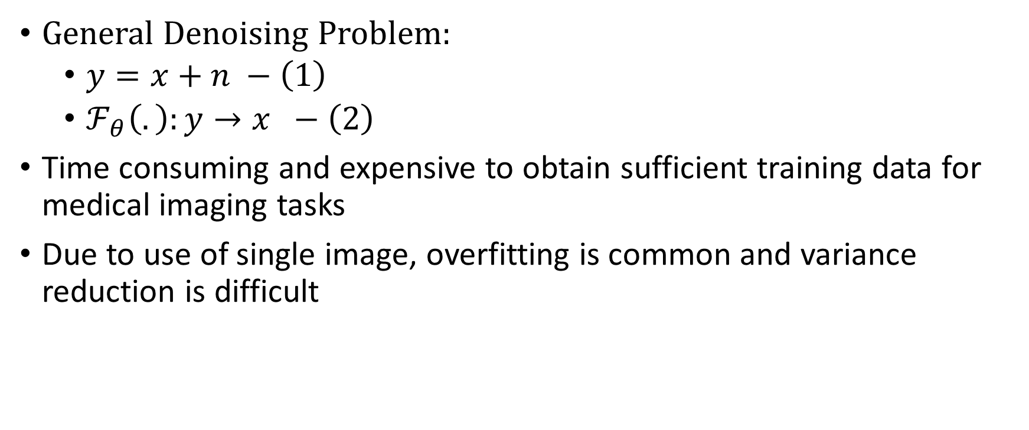
Problem Statement and Motivation
General Denoising Problem:
$y=x+n −\left(1\right)$
$ℱ_{θ}\left(.\right):y→x −\left(2\right)$
Time consuming and expensive to obtain sufficient training data for medical imaging tasks
Due to use of single image, overfitting is common and variance reduction is difficult

Slide 4
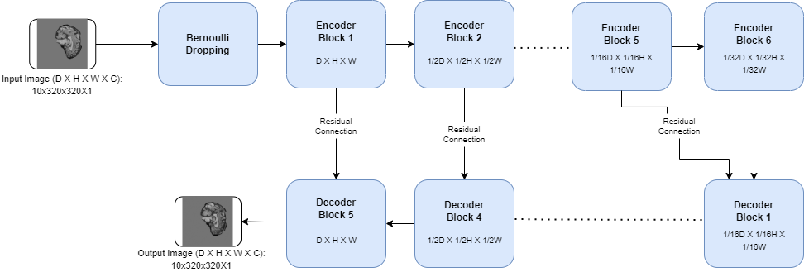

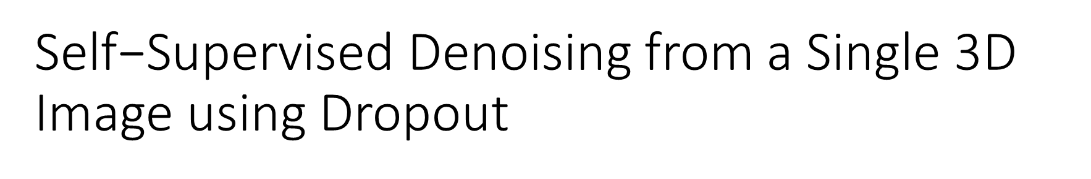
$\text{Self}\text{−}\text{Supervised} \text{Denoising}$from a Single 3D Image using Dropout
Motivated by previous work on denoising 2-dimensional images through self-supervised${NNs}^{1,2,3}$

Slide 5
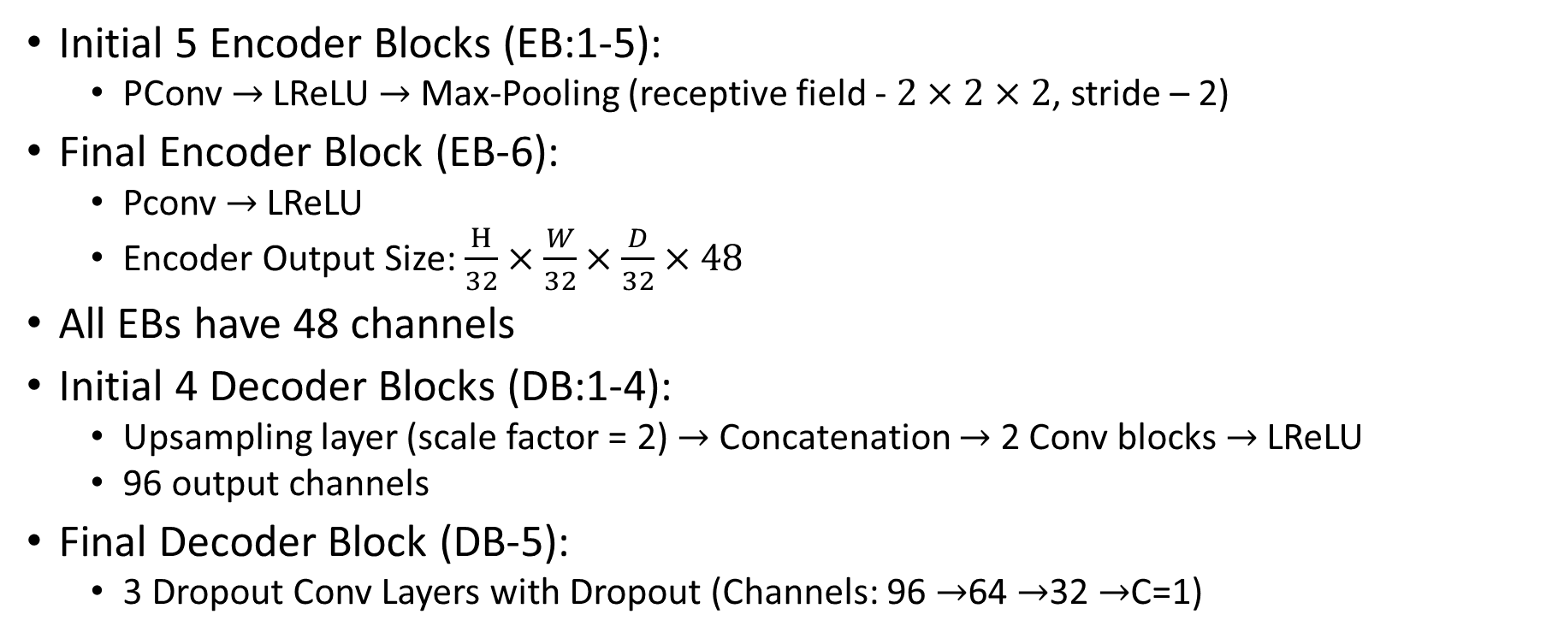
Architecture Details
Initial 5 Encoder Blocks (EB:1-5):
PConv$→$ LReLU $→$ Max-Pooling (receptive field - $2×2×2$, stride – 2)
Final Encoder Block (EB-6):
Pconv $→$ LReLU
Encoder Output Size: $\frac{H}{32}×\frac{W}{32}×\frac{D}{32}×48$
All EBs have 48 channels
Initial 4 Decoder Blocks (DB:1-4):
Upsampling layer (scale factor = 2) $→$ Concatenation $→$ 2 Conv blocks $→$ LReLU
96 output channels
Final Decoder Block (DB-5):
3 Dropout Conv Layers with Dropout (Channels: 96 $→$64 $→$32 $→$C=1)

Slide 6
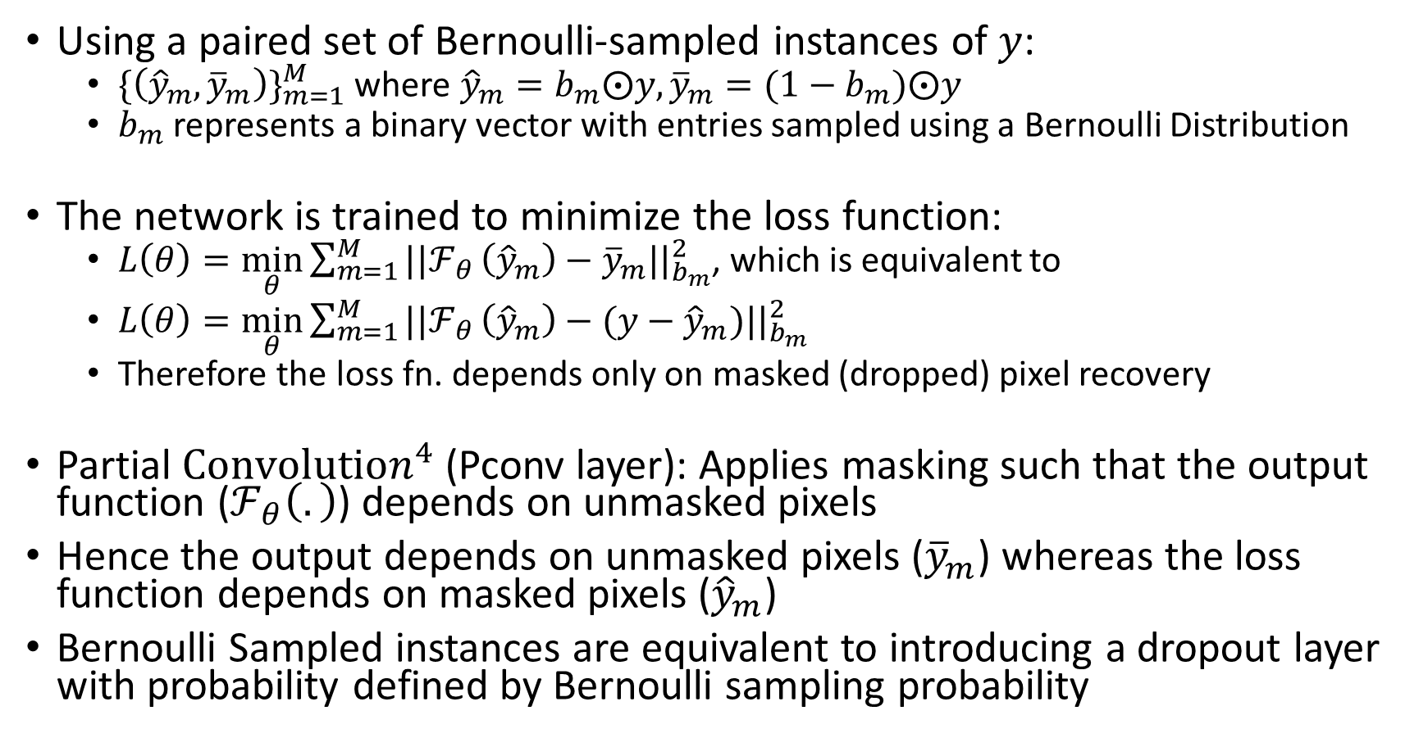
Training Scheme
Using a paired set of Bernoulli-sampled instances of $y$:
${\{\left({\hat{y}}_{m},{\overline{y}}_{m}\right)\}}_{m=1}^{M}$ where ${\hat{y}}_{m}=b_{m}⨀y, {\overline{y}}_{m}=(1−b_{m})⨀y$
$b_{m}$ represents a binary vector with entries sampled using a Bernoulli Distribution
The network is trained to minimize the loss function:
$L\left(θ\right)=\min_{θ}{\sum_{m=1}^{M}{||ℱ_{θ}}}\left({\hat{y}}_{m}\right)−{\overline{y}}_{m}||_{b_{m}}^{2}$, which is equivalent to
$L\left(θ\right)=\min_{θ}{\sum_{m=1}^{M}{||ℱ_{θ}}}\left({\hat{y}}_{m}\right)−(y−{\hat{y}}_{m})||_{b_{m}}^{2}$
Therefore the loss fn. depends only on masked (dropped) pixel recovery
Partial $Convolution^{4}$ (Pconv layer): Applies masking such that the output function ($ℱ_{θ}\left(.\right)$) depends on unmasked pixels
Hence the output depends on unmasked pixels (${\overline{y}}_{m}$) whereas the loss function depends on masked pixels (${\hat{y}}_{m}$)
Bernoulli Sampled instances are equivalent to introducing a dropout layer with probability defined by Bernoulli sampling probability

Slide 7
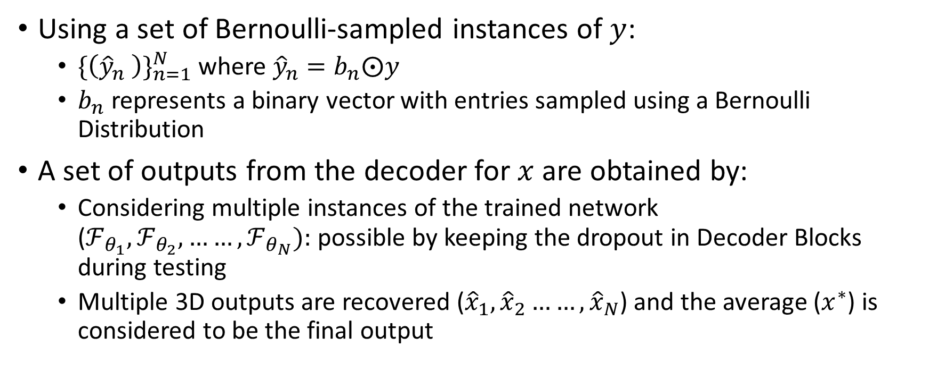
Denoising Scheme
Using a set of Bernoulli-sampled instances of $y$:
${\{\left({\hat{y}}_{n} \right)\}}_{n=1}^{N}$ where ${\hat{y}}_{n}=b_{n}⨀y$
$b_{n}$ represents a binary vector with entries sampled using a Bernoulli Distribution
A set of outputs from the decoder for $x$ are obtained by:
Considering multiple instances of the trained network ($ℱ_{θ_{1}},ℱ_{θ_{2}},……,ℱ_{θ_{N}}):$possible by keeping the dropout in Decoder Blocks during testing
Multiple 3D outputs are recovered (${\hat{x}}_{1},{\hat{x}}_{2}……,{\hat{x}}_{N}$) and the average ($x^{∗}$) is considered to be the final output

Slide 8
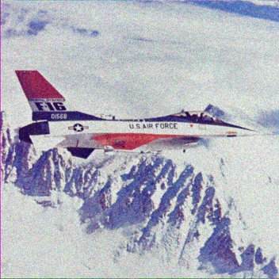
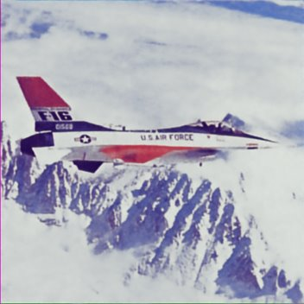
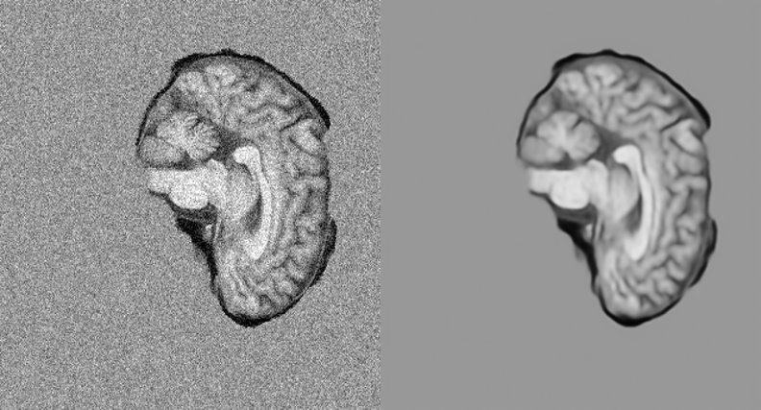
Experiments
With 2D Image data:
S & P noise with 60%
probability
2-D Network Output
After 10,000 steps
Noisy and Denoised Images for central
slice with x-coefficient constant

Slide 9
3-D Brain MRI data (Visual Results)

Slide 10
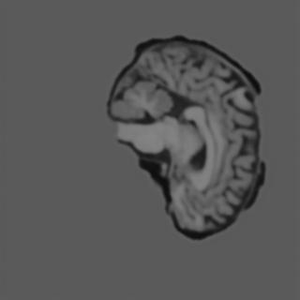



Visual Results over 20 iterations
EPOCH: 1,000 10,000 15,000 20,000

Slide 11
Numerical Results (Peak Signal to Noise Ratio)
Epoch (1000s) | PSNR (dB)
1 | 20.20
2 | 20.46
3 | 20.52
4 | 20.54
5 | 20.57
6 | 20.61
7 | 20.63
8 | 20.65
9 | 20.68
10 | 20.71
Epoch (1000s) | PSNR (dB)
11 | 20.73
12 | 20.74
13 | 20.76
14 | 20.77
15 | 20.78
16 | 20.79
17 | 20.80
18 | 20.81
19 | 20.81
20 | 20.82

Slide 12
Discussion
Run the model for higher number of epochs
Add robustness to the model through data augmentation before forward pass
Make use of matrix completion techniques from convex optimization tasks to improve on loss function
Comparison with results from supervised Neural Networks such as GANs

Slide 13
References
Batson, J. and Royer, L., 2019, May. Noise2self: Blind denoising by self-supervision. In International Conference on Machine Learning (pp. 524-533). PMLR.
Krull, A., Vičar, T., Prakash, M., Lalit, M. and Jug, F., 2020. Probabilistic noise2void: Unsupervised content-aware denoising. Frontiers in Computer Science, 2, p.5.
Quan, Y., Chen, M., Pang, T. and Ji, H., 2020. Self2self with dropout: Learning self-supervised denoising from single image. In Proceedings of the IEEE/CVF Conference on Computer Vision and Pattern Recognition (pp. 1890-1898).
Liu, G., Reda, F.A., Shih, K.J., Wang, T.C., Tao, A. and Catanzaro, B., 2018. Image inpainting for irregular holes using partial convolutions. In Proceedings of the European Conference on Computer Vision (ECCV) (pp. 85-100).

